Slide 1
Maven Lifecycle
Presented By: Vaibhav Gupta (VG029260)
Notes:
Maven in a gist…
Tool to move away from painful Ant scripts
Tool to build and manage java based projects

Slide 2
Maven, what it brings on the plate ?
standard way to build the projects
a clear definition of what the project consisted of
an easy way to publish project information
a way to share JARs across several projects.
Notes:
While maven lets you do the following, its Not?
a site and documentation tool
Doesn’t extends Ant to let you download dependencies
a set of reusable Ant scriptlets

Slide 3
Maven Jargon's…
Goals - are specific tasks, finer than phases; e.g.: dependency:copy-dependencies
Phases – they are basically the steps or processes the build goes through; e.g.: clean, package
Build Lifecycle – A Build Lifecycle is a well defined sequence of phases which define the order in which the goals are to be executed.
Example of a typical maven command :-
mvn clean dependency:copy-dependencies package
NOTE: There are two ways to assign goals to each build phase, one via packaging type and other via plugins.
Notes:
A Build Lifecycle is Made Up of “Phases”
A given phase is made up of different plugin goals and even though a build phase is responsible for a specific step in the build lifecycle, the manner in which it carries out those responsibilities may vary. And this is done by declaring the plugin goals bound to those build phases
Every maven phase runs all the preceding phases of its lifecycle

Slide 4
Types of build lifecycles…
Maven defines three types of build lifecycles, namely :-
Default (build) lifecycle
Clean lifecycle
Site lifecycle

Slide 5
Default Lifecycle
Most commonly used build phases (out of the 23 available phases) are:
validate - validate the project is correct and all necessary information is available
compile - compile the source code of the project
test - test the compiled source code using a suitable unit testing framework. These tests should not require the code be packaged or deployed
package - take the compiled code and package it in its distributable format, such as a JAR.
verify - run any checks on results of integration tests to ensure quality criteria are met
install - install the package into the local repository, for use as a dependency in other projects locally
deploy - done in the build environment, copies the final package to the remote repository for sharing with other developers and projects.
Notes:
default lifecycle is defined without any associated plugin and has 23 phases in total.
Some phases have goals bound to them by default. And for the default lifecycle, these bindings depend on the packaging value
plugin bindings are defined separately in default-bindings.xml

Slide 6
Clean Lifecycle
pre-clean - execute processes needed prior to the actual project cleaning
Clean - remove all files generated by the previous build
post-clean - execute processes needed to finalize the project cleaning

Slide 7
Site Lifecycle
pre-site - execute processes needed prior to the actual project site generation
site - generate the project's site documentation
post-site - execute processes needed to finalize the site generation, and to prepare for site deployment
site-deploy - deploy the generated site documentation to the specified web server

Slide 8
Example of goals binding: jar packaging
process-resources | resources:resources
compile | compiler:compile
process-test-resources | resources:testResources
test-compile | compiler:testCompile
test | surefire:test
package | jar:jar
install | install:install
deploy | deploy:deploy

Slide 9
Example of goals binding: plugins
<plugin>
<groupId>com.mycompany.example</groupId>
<artifactId>display-maven-plugin</artifactId>
<version>1.0</version>
<executions>
<execution>
<phase>process-test-resources</phase>
<goals>
<goal>time</goal>
</goals>
</execution>
</executions>
</plugin>

Slide 10
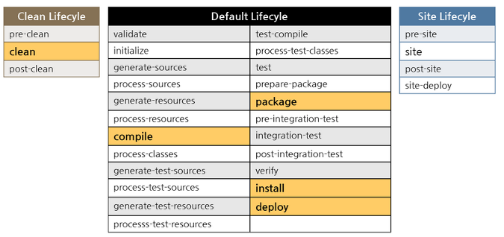
To Summarize…

Slide 11
References
https://maven.apache.org/
https://maven.apache.org/guides/introduction/introduction-to-the-lifecycle.html#Plugins
https://maven.apache.org/ref/3.3.9/maven-core/lifecycles.html
http://www.tutorialspoint.com/maven/maven_build_life_cycle.htm

Slide 12
Questions ?

